Slide 1
Dr. Yifeng Zhu Electrical and Computer Engineering University of Maine
Embedded Systems
Lab 5:
AHRS: Attitude and Heading Reference System
Spring 2019

Slide 2
The ST Drone’s AHRS:
An Attitude and Heading Reference System (AHRS) is used by the ST Drone to estimate its current position and orientation
This information is used by the PID Controller alongside user input to determine the correct motor speeds for accurate flight control
The sensors configured in the previous lab are used by the AHRS to produce position estimates

Slide 3
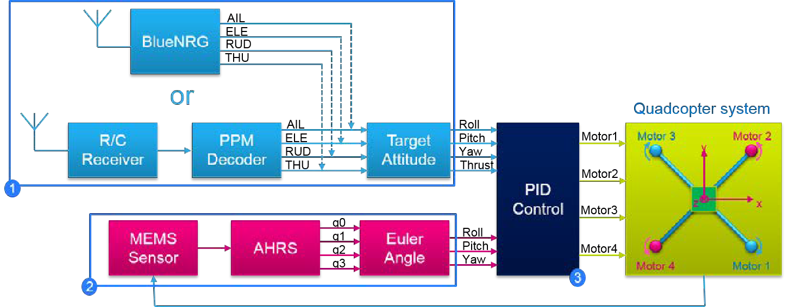
The ST Drone’s AHRS:
Section 2, labelled in the below image, is the focus of this lab.
This section takes sensor data from the drone as an input, and outputs an orientation in the form of the three aircraft principal axes. (Roll, Pitch, and Yaw)

Slide 4
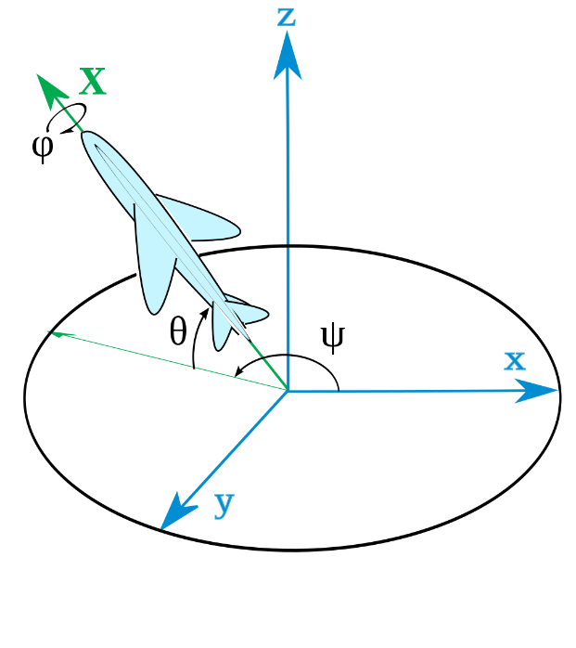
Aircraft Principal Axes:
The Aircraft Principal Axes, Roll, Pitch, and Yaw, are used to represent the orientation of various aeronautical devices.
Yaw, a rotation about the
Z-axis, is represented by ψ
Pitch, a rotation about the
Y-axis, is represented by θ
Roll, a rotation about the
plane’s axis, is represented by Ф

Slide 5
Euler Angles:
The Aircraft Principal Angles are actually a special type of Euler Angles known as Tait-Bryan Angles
Euler Angles are a commonly used method of representing orientation, as they can do so cleanly using only 3 variables.
The three variables in a set of Euler Angles represent the amount of rotation around three axes.
The axes that are rotated about differ depending on the type of Euler Angles used. Tait-Bryan Angles are one example of this.

Slide 6
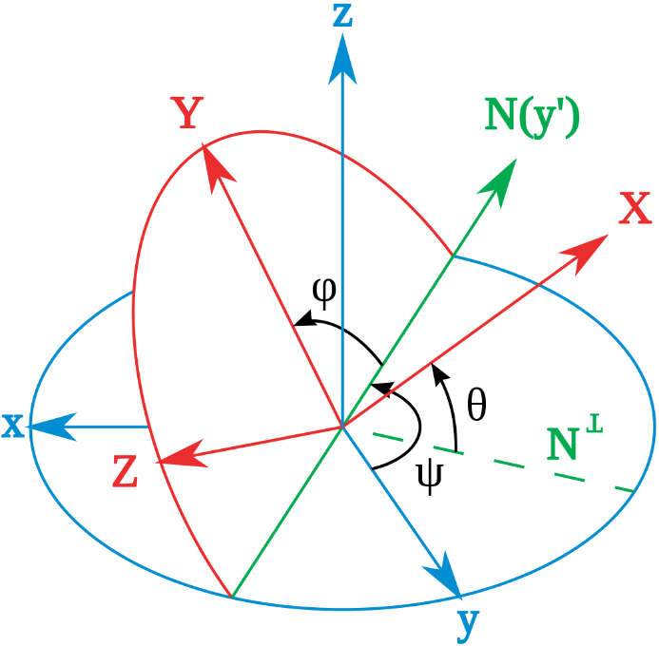
Tait-Bryan Rotation:
As shown below, a Tait-Bryan orientation is reached through the following method.
First, the axes rotate about
the Z-axis by angle ψ
Next, the axes rotate about
the current Y-axis by θ
Finally, the axes rotate about
the current X-axis by Ф

Slide 7
Tait-Bryan Rotation:
It can be seen, when comparing the previous two images, that the Aircraft Principal axes are indeed calculated using Tait-Bryan Angles

Slide 8
Quaternions:
As you might have noticed in the original block diagram, before producing the output Euler Angles, the AHRS algorithm first produces a quaternion
Quaternions are another method of representing an object’s orientation in 3D space
Quaternions are a 4D vector where the first value represents the size of the rotation, and the other three represent the axis to rotate about

Slide 9
Quaternions:
The last three values are essentially a 3D vector representing the axis to rotate about, with each value corresponding to the X, Y, and Z axes, respectively
The mathematical representation of the quaternion allows for calculations to be quickly and easily performed, making it a favorite for projects with real-time constraints
More information on the mathematical representation of quaternions can be found in the lab handout

Slide 10
The AHRS Algorithm:
The AHRS Algorithm produces output Euler Angles through the following method:
The AHRS periodically samples data from the gyroscope and accelerometer
The AHRS integrates the velocity and acceleration data, while accounting for error, to produce a position estimate in the form of quaternion
The quaternion is converted to a set of Tait-Bryan angles and output to the PID Controller
More information regarding the algorithm can also be found in the lab handout

Slide 11
The Lab:
The goal of this lab is to demonstrate a basic understanding of the AHRS algorithm
Code that performs the AHRS algorithm will be provided, and must be used to produce various outputs
These outputs will be both verbally and graphically compared to determine accuracy

